Slide 1
Suspended Observing Jan 2010
Four objectives
Transfer the IF signal path from VLA to WIDAR correlator
Rebuild the IF distribution racks (2)
Rework the LO central racks (3)
Overhaul & outfit the MLO rack (1)
Notes:
Welcome
Purpose of this presentation is to (1) show critical work involved during shutdown and (2) identify any issues, potential problems, or previously unidentified consequences to the work involved. Here are the four objectives for the work during this shutdown period.
There are about a dozen people from at least three groups performing these tasks and all are very aware of the significance to halting observing.
I will talk about the first two objectives and Rob will discuss the last two.

Slide 2
Suspended Observing Jan 2010
Four objectives
Transfer the IF signal path from VLA to WIDAR correlator
Move Deformatter boards to Station Boards
Move optical Demuxs to Widar Racks
Rebuild the IF distribution racks (2)
Rework the LO central racks (3)
Overhaul & outfit the MLO rack (1)
Notes:
The first objective can be broken down into two sub objectives. Moving of the deformatter boards to the Station boards is mostly performed by the correlator group with help from the DAQ group.
The relocation of the optical Demuxs will be performed by Linda from the Fiber group.

Slide 3
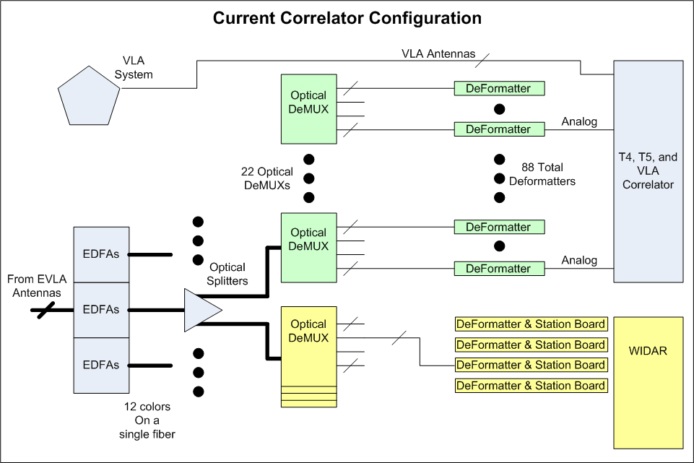
Notes:
This slide shows a block diagram of the current set up of the fiber optic IF path in the correlator room. The blocks in green is what is being moved to the final location in the WIDAR racks.

Slide 4
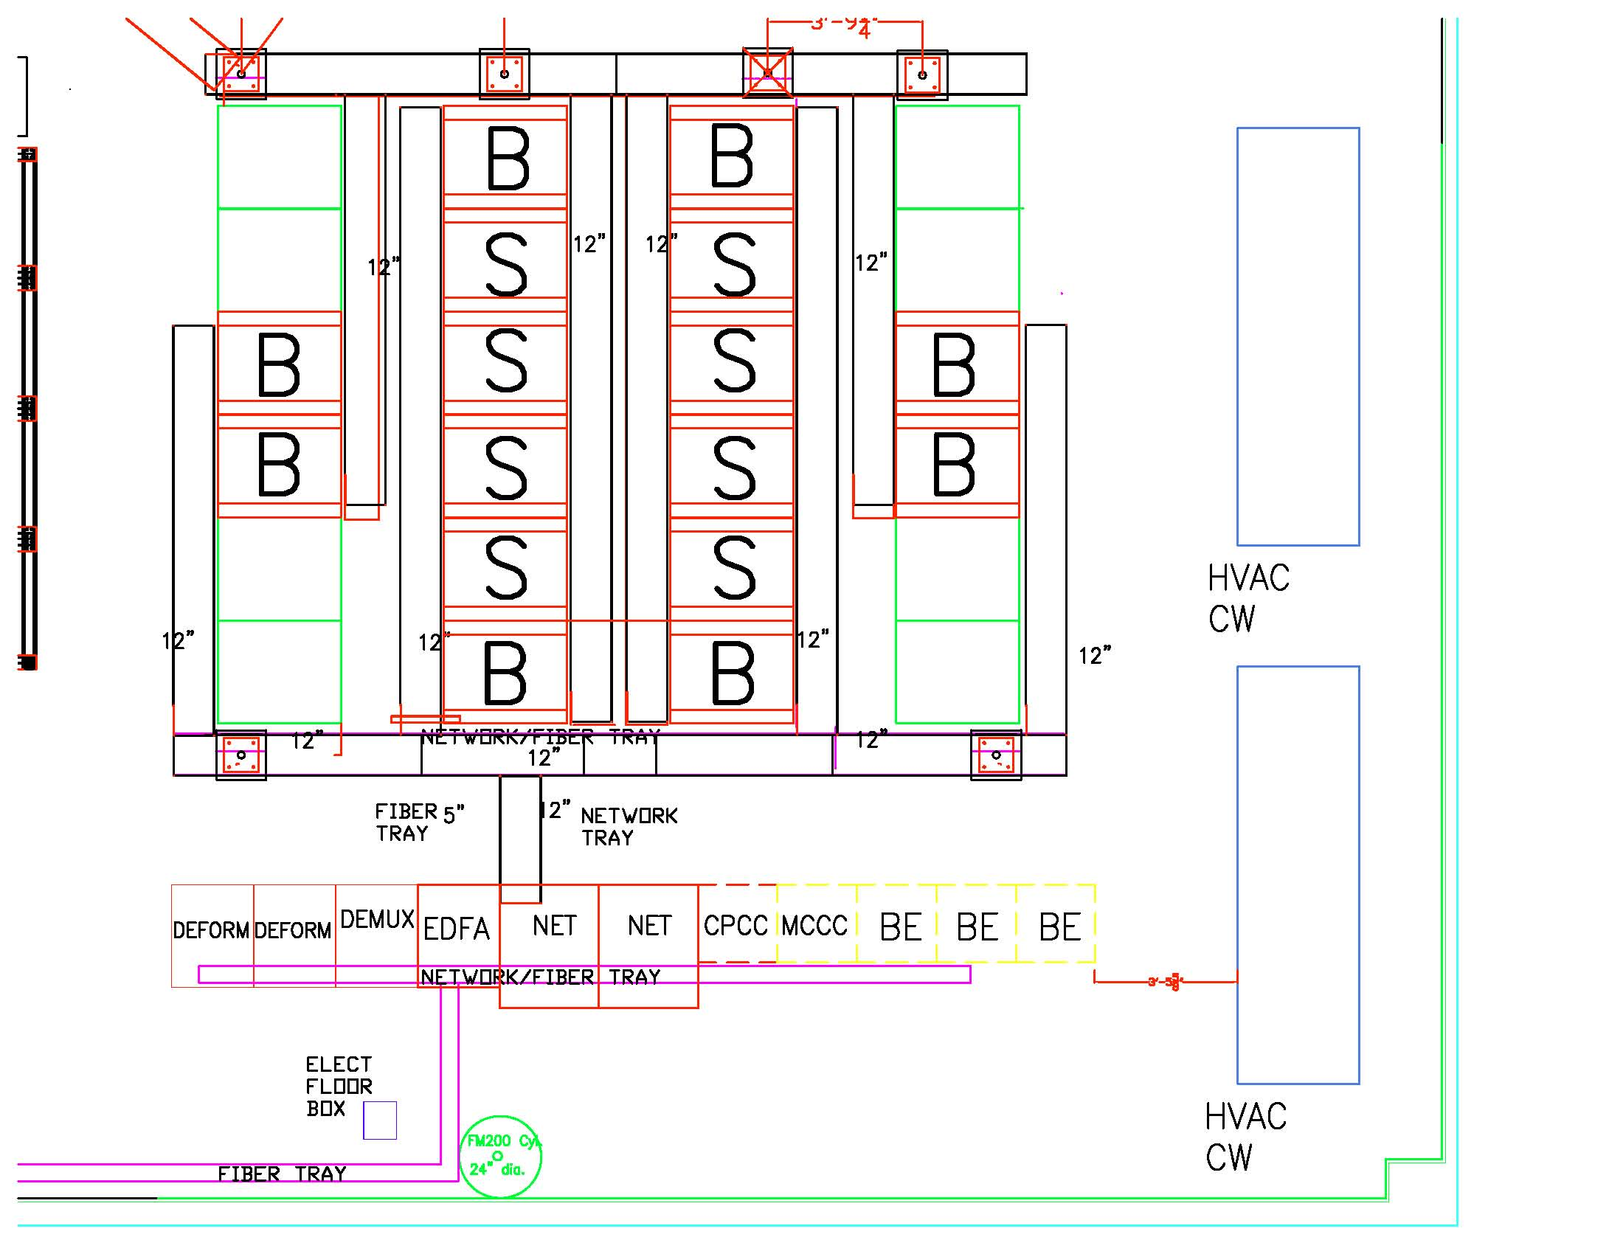
Current Status
Antennas
1-4
Antennas
25-28
Antennas
5-8
Antennas
21-24
Antennas
9-12
Antennas
17-20
Antennas
13-16
Notes:
This is the floor plan of the correlator room. The area on the left is the power plant and the upper right is where the tables and equipment will be set up for performing a lot of the work. The tables will have ESD mats on them and all
It is these four racks where a lot of the equipment will be moved from and it will be moved to seven of the 8 station racks. The deformatter will be moved from these racks to the work area in an ESD safe cart.
The station boards for the antennas are in sequence and are shown .

Slide 5
Notes:
Here is a photograph of the four racks that currently house the IF fiber equipment.
The rack on the left has the EDFAs (Erbium Doped Fiber Amplifier) and the IF distribution panels.
The next rack hold the optical DEMUXs that split each antenna’s signal into their 12 colors. Currently each tray hold a single DEMUX for one antenna.
The next two racks hold the 88 deformatters that have to be moved onto the Station Boards.

Slide 6
Notes:
Here is a shot of the back of the racks that show a little better the interconnections that have to be disconnected.
After power is secured, the first step that will be done is to disconnect everything within these racks. The power cables, the fiber, the network connections and the coax going back to the electronics room will be removed so the deformatter boards are free to be removed as needed.
As each deformatter board is removed, the temporary face plate will be removed.

Slide 7
Notes:
After the face plate is removed, the three power supply boards and the CMIB is removed. This allows the connectors to be press fit onto the board. After the connectors are installed with the hydraulic press. Then the three power supply boards and CMIB are re-installed back onto the deformatter boards. Every step is performed observing proper grounding for ESD controls.

Slide 8
Notes:
Here is a shot of the deformatter board being installed onto a Station board. Only the Correlator group will handle the Station boards.
This step will be performed in front of the Station rack. On a grounded movable cart, the Station Board is removed from the rack, placed on the cart, the deformatter board installed and the station board put back into the rack.

Slide 9
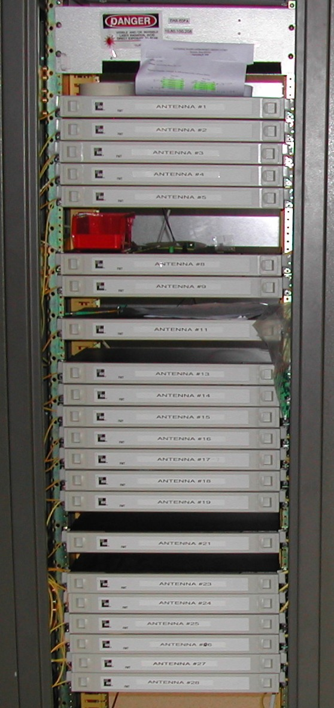
Move DEMUXs to WIDAR Racks
Notes:
The fiber group will move the DEMUXs from the individual trays into the aluminum enclosures that get installed in the Station Racks.
The enclosures are already made with the bulkhead connectors already installed.
The fibers going from the new DEMUX enclosure to the Station Boards are new and already made up.

Slide 10
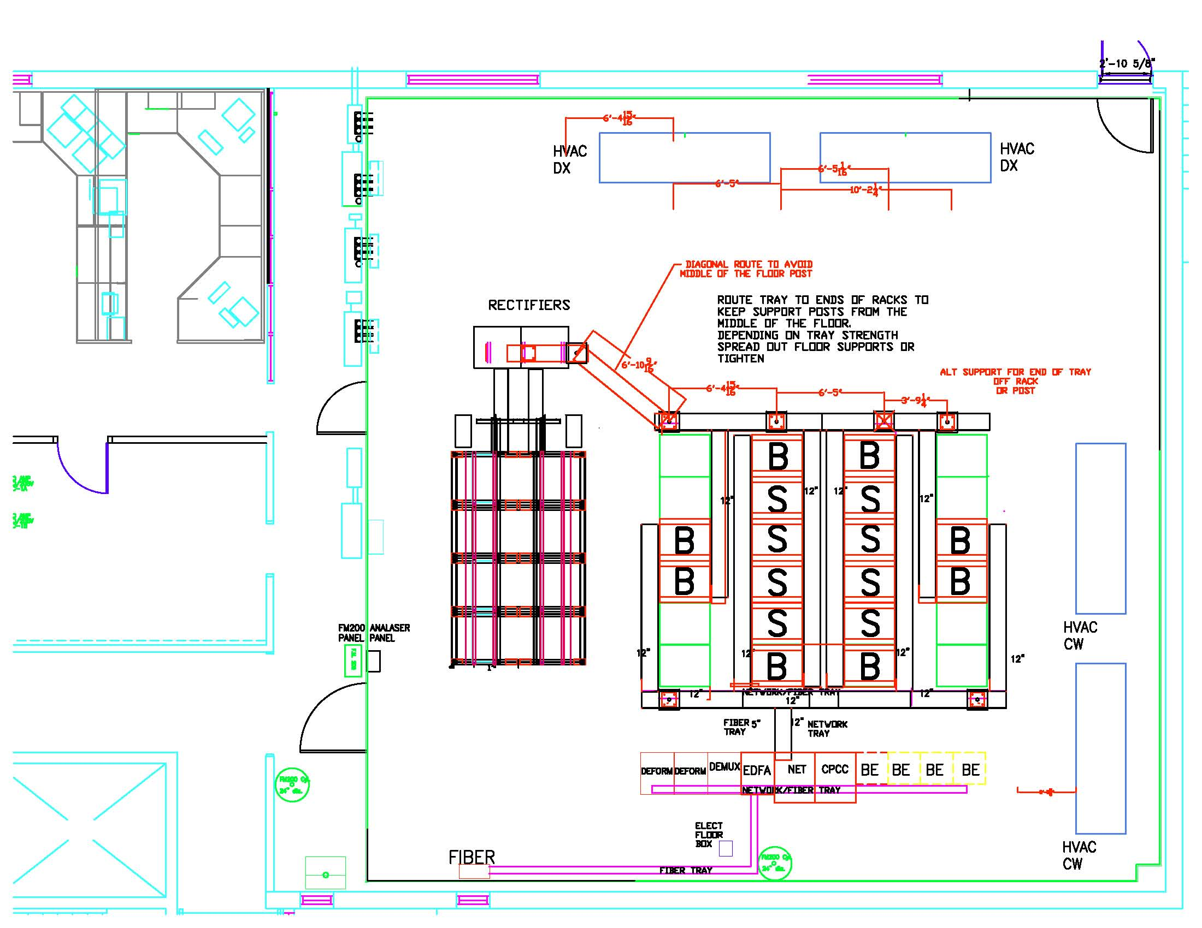
Notes:
Two work tables will be set up for disassembly and reassembly of the deformatter boards. ESD mats will be placed on the work spaces and tested before work begins. The hydraulic press used to install the connectors will be placed in between the tables.
The deformatter boards will be transferred from the racks to the work spaces on an ESD safe cart.
Likewise, the deformatter boards will be transferred to the Station Racks on a cart. On the grounded movable cart, the Station Board is removed from the rack, placed on the cart, the deformatter board installed and the station board put back into the rack.

Slide 11
Suspended Observing Jan 2010
Four objectives
Transfer the IF signal path from VLA to WIDAR correlator
Rebuild the IF distribution racks (2)
Rework the LO central racks (3)
Overhaul & outfit the MLO rack (1)
Notes:
Since the fiber for the IF path is already interrupted, we are also going to rebuild the IF distribution racks.

Slide 12
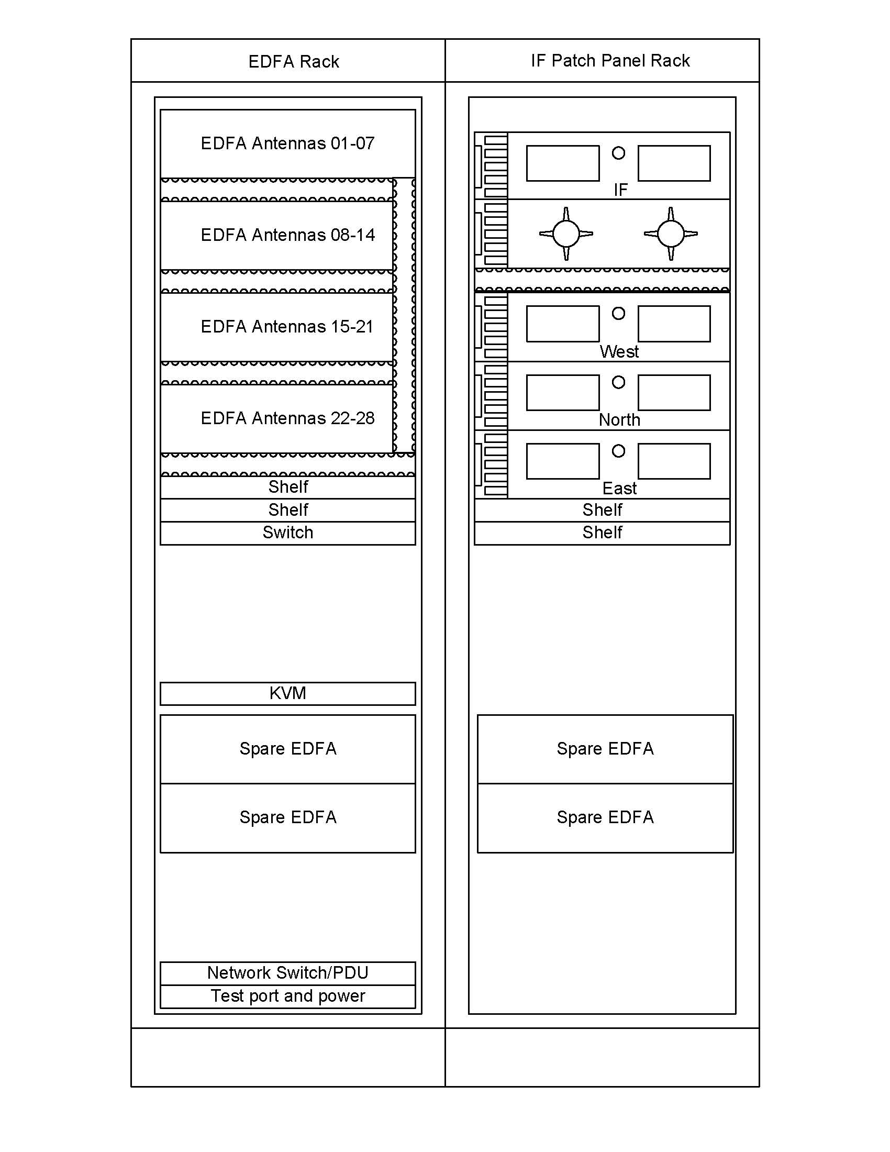
Notes:
The racks shown on the left are going to be rebuilt to the design shown on the right. The EDFA cassettes are being replaced to increase reliability.
The current design with a single Master controller has a single point of failure. If the master controller dies, all antennas requiring an amplifier will also die. So the controllers are being replaced with four independent chassis and each will have up to seven antennas. A new rack is already built with the new equipment and will replace the left rack.
In addition the IF patch panels where the IF for an antennas is connected after it gets moved will be relocated into the next rack at a much more comfortable working height.
We are adding drawers to hold attenuators and fiber cleaning supplies as well as a KVM to access the EDFA amplifiers locally. The spare cassettes will be stored in the bottom of the racks if needed.

Slide 13
Notes:
The rebuild of the IF distribution racks will require moving of one of the fiber trays. The fiber is completely removed and coiled overhead until the work is completed. The far left rack is completely removed and the new EDFA rack in installed in its place.
The remaining racks that were emptied will remain in the correlator room for future expansion.

Slide 14
Suspended Observing Jan 2010
Four objectives
Transfer the IF signal path from VLA to WIDAR correlator
Rebuild the IF distribution racks (2)
Rework the LO central racks (3)
Overhaul & outfit the MLO rack (1)

Slide 15
LO Rack Rework
Remove all LO modules
Reposition module bins
Reroute/install semi-rigid coax
Install proper wiring harnesses (8 new harnesses being built)
Install new power distribution
Install & test new P351s
Clean up cable routing and fiber installation
Ensure proper airflow in racks
Notes:
The new load-sharing power distribution boards require shifting the bottom 3 bins (only) down 1U. In LO-A, & LO-B racks this will also mean repositioning the semi-rigid coax. In LO-C rack new semi-rigid coax will be installed.
RFI covers will be properly installed.
Will airflow be adequate when old correlator is shut off? What is HVAC plan?

Slide 16
Suspended Observing Jan 2010
Four objectives
Transfer the IF signal path from VLA to WIDAR correlator
Rebuild the IF distribution racks (2)
Rework the LO central racks (3)
Overhaul & outfit the MLO rack (1)

Slide 17
MLO Rack Overhaul
Remove all MLO modules
Reposition module bins
Install new feed through panels
Install semi-rigid coax
Install new wiring harnesses (harnesses being built)
Install new power distribution
Install & test new P350s
Install and test new L350s, L356, L357, L358, and L359s
Notes:
MLO rack requires most work & time. The rack will be completely gutted and rebuilt. New feedthrough panels are in Hollis’s queue. New wire harnesses, RF cabling, twinax cabling, DC power and AC power distribution is in the works. 2 more bins need to be added to the rack.
Dana working on new harnesses with input from me, Keith, Matt, Leon, & Terry. Many parts still need to be ordered!! Awaiting Tensolite for ordering twinax cable (to build our own cable assemblies). We need drafting support ASAP (computer problems) in order to finish drawings needed to order parts!

Slide 18
MLO Rack Overhaul (cont.)
Install two GPS receivers and associated cabling (including two media converters)
Install rubidium and cabling
Clean up fiber routing and test new fiber runs (two 12 fiber cables installed and connected to properly configured switch)
Install AC power filters for GPS, Rubidium, media converters
Ensure proper airflow in rack
Notes:
A new GPS antenna for the 2nd receiver needs to be mounted on the roof and 75 ohm cable run for both antennas. We will use separate media converters for each GPS receiver.
Are new fiber cables run to the MLO rack? Is the network switch properly configured for all MLO modules?
Airflow is (again) critical!!

Slide 19
Miscellaneous
L305 modules need to be upgraded in all antennas for 10/20 Hz timing
A new GPS antenna needs to be installed on roof and cabling run to MLO rack
Shut down of VLBA racks and unused VLA hardware
Remove WWV antenna and cabling
Should newer Maser be put online

Slide 20
January
Sunday | Monday | Tuesday | Wednesday | Thursday | Friday | Saturday
 |  |  |  |  | 1 | 2
3 | 4 | 5 | 6 | 7 | 8 | 9
10 | 11 | 12 | 13 | 14 | 15 | 16
17 | 18 | 19 | 20 | 21 | 22 | 23
24 | 25 | 26 | 27 | 28 | 29 | 30
February
31 | 1 | 2 | 3 | 4 | 5 | 6
7 | 8 | 9 | 10 | 11 | 12 | 13
14 | 15 | 16 | 17 | 18 | 19 | 20
21 | 22 | 23 | 24 | 25 | 26 | 27
Set up equipment
Electronics Division
Hardware work
Electronics Division
Hardware testing and checkout
WIDAR Correlator
Testing
Notes:
The week after the New Years Holiday will be used to set up the equipment in the correlator room. The tables, the press, and the new EDFA rack will be staged in the correlator room. ESD mats will be installed on the tables and check.
The first day will be used by Ken to take measurements and analyze after observing has finished.
There are two weeks for the Electronics Division hardware work followed by up to two weeks of hardware testing and checkout.
The dates shown match the EVLA targets dates.

Slide 21
Critical Systems
 | Powered Down | Down then up | Remains ON
VLA Correlator
Widar Correlator
CBE Computers
Archive (VLA/WIDAR vis data)
CPCC computer
VLBA Equipment
D Racks
H Maser
Rubidium
Master LO System
IF (DTS) System
GPS
CMP
Weather Station
API
Serial Line Controller
Computers outside Correlator Room
Fire Alarms
Wyemon
LWDA networking
Notes:
Here is a list of some of the systems and their status during this period.
An X in the red column means the system will be turned OFF and will not be turned back ON.
An X in the yellow column means the systems will be turned OFF or will not be functional but will be restored at the end of the period.
An X in the Green column means the system will remain ON during the work.

